Slide 1
Statistical Foundations of
Unsupervised Learning
Concepts, Models, Assumptions & Algorithms
Topics: The Unsupervised Problem · Clustering (K-Means, Hierarchical, Gaussian Mixture Models) · Dimensionality Reduction (PCA, t-SNE, UMAP) · Density Estimation · Autoencoders · Model Evaluation

Slide 2
Lecture Roadmap
1
6
The Unsupervised Learning Problem
Nonlinear Reduction: t-SNE & UMAP
2
7
Clustering I: K-Means & Its Assumptions
Density Estimation
3
8
Clustering II: Hierarchical & Density-Based
Autoencoders & Representation Learning
4
9
Clustering III: Gaussian Mixture Models & EM
Evaluating Unsupervised Models
5
Dimensionality Reduction: PCA

Slide 3
SECTION 1
The Unsupervised Learning Problem

Slide 4
Supervised vs. Unsupervised: A Fundamental Distinction
Supervised Learning
Unsupervised Learning
Labeled training data: {(xᵢ, yᵢ)}ⁿᵢ₌₁
Target variable y is known and explicit
Goal: learn f: X → Y minimizing prediction loss
Evaluation is straightforward: compare ŷ to y
Assumes P(Y|X) or P(X,Y) is estimable from labels
Unlabeled data: {xᵢ}ⁿᵢ₌₁ — no y observed
No external criterion to predict
Goal: discover structure in P(X) itself
Evaluation is inherently harder — no ground truth
Assumes structure exists: clusters, manifolds, factors
Key challenge: without y, what does 'correct' mean? The answer defines the method.

Slide 5
What Structure Are We Looking For? A Taxonomy
Clustering
Dimensionality Reduction
Partition X into groups (clusters) such that within-group observations are more similar than between-group ones.
Examples: K-Means, GMMs, DBSCAN, Hierarchical Clustering
Find a low-dimensional representation z ∈ ℝᵏ (k≪p) that preserves the essential structure of x ∈ ℝᵖ.
Examples: PCA, ICA, t-SNE, UMAP, Autoencoders
Density Estimation
Representation Learning
Estimate the probability density P(X) from which the data were drawn.
Examples: KDE, Gaussian Mixture Models, Normalizing Flows
Learn latent features (embeddings) that encode meaningful structure for downstream tasks.
Examples: Autoencoders, VAEs, word2vec, contrastive learning
Many methods serve multiple goals simultaneously: GMMs do both density estimation and clustering; autoencoders do both dimensionality reduction and representation learning.

Slide 6
Foundational Assumptions of Unsupervised Methods
Every unsupervised method encodes prior assumptions about what kind of structure is worth finding.
Assumption
What It Means
Key Methods
Smoothness / Continuity
Nearby points in X-space belong to the same cluster or lie on the same manifold
K-Means, KDE, UMAP
Cluster Compactness
Groups have higher internal density than boundary regions; each cluster has a natural 'center'
K-Means, GMM, DBSCAN
Low-Dimensional Manifold
High-dimensional data lies near a low-dimensional manifold embedded in ℝᵖ
PCA, t-SNE, UMAP, Autoencoders
Statistical Independence
Latent sources or components are independent (or orthogonal) of one another
PCA (orthogonality), ICA (independence)
Generative Model Existence
Observed data were generated by a tractable latent variable model
GMM, VAE, Factor Analysis
i.i.d. Sampling
Observations are drawn independently from the same distribution P(X)
All methods

Slide 7
SECTION 2
Clustering I: K-Means & Its Assumptions

Slide 8
K-Means Clustering: Algorithm & Objective Function
Minimize: W(C) = Σₖ Σ_{i∈Cₖ} ‖xᵢ − μₖ‖² (within-cluster sum of squares, WCSS)
Lloyd's Algorithm (Coordinate Descent on WCSS)
Key Assumptions & Limitations
1
Initialize: Choose K cluster centroids μ₁,…,μₖ (random, K-Means++, or user-specified)
K must be specified in advance — not inferred from data
Use elbow plot, silhouette, or gap statistic to choose K
Assumes clusters are convex, isotropic, and similarly sized
Fails on elongated, ring-shaped, or very unequal clusters
Euclidean distance encodes implicit spherical Gaussian assumption
Sensitive to outliers (outliers pull centroids)
Non-convex objective — algorithm finds local minimum, not global
Run multiple restarts; K-Means++ initialization reduces instability
Complexity: O(n·K·p·T) per iteration — scales well
2
Assign: Assign each xᵢ to nearest centroid: Cₖ = {i : k = argmin_j ‖xᵢ−μⱼ‖²}
3
Update: Recompute centroids as cluster means: μₖ = (1/|Cₖ|) Σ_{i∈Cₖ} xᵢ
4
Repeat: Iterate steps 2–3 until assignments do not change (convergence guaranteed — WCSS decreases monotonically)

Slide 9
Choosing K: Elbow, Silhouette & Gap Statistic
Elbow Method
Silhouette Score
Gap Statistic (Tibshirani 2001)
W(K) = Σₖ Σ_{i∈Cₖ} ‖xᵢ−μₖ‖²
s(i) ∈ [−1, 1]; higher = better
Gap(K) = 𝔼*[log Wₖ] − log Wₖ
Plot WCSS vs. K. Look for the 'elbow' — the point where marginal reduction in WCSS diminishes sharply.
Limitation: elbow is often ambiguous and subjective. Best used as a first-pass heuristic.
For each point i, compute:
a(i) = mean intra-cluster distance
b(i) = mean nearest-cluster distance
s(i) = [b(i)−a(i)] / max(a(i),b(i))
Average s(i) over all points. Range: [−1, 1]. Maximize over K.
Compare observed log(W(K)) to its expectation under a null reference distribution (uniform data with no cluster structure).
Gap(K) = E*[log W(K)] − log W(K)
Choose smallest K where Gap(K) ≥ Gap(K+1) − SE.
No single method is definitive — use multiple criteria and domain knowledge. K-selection is as much art as science.

Slide 10
SECTION 3
Clustering II: Hierarchical & Density-Based

Slide 11
Hierarchical Clustering: Agglomerative & Divisive
Key advantage: does not require specifying K in advance. Output is a dendrogram — a full hierarchy of merges.
Agglomerative (Bottom-Up)
DBSCAN: Density-Based Approach
Start with n singleton clusters
Iteratively merge the two closest clusters
Stop when one cluster remains (or at desired K)
Linkage criteria determine 'closest':
Single: min inter-cluster distance → chaining effect
Complete: max inter-cluster distance → compact clusters
Average (UPGMA): mean of all pairwise distances
Ward: minimizes increase in total WCSS on merge
Complexity: O(n²) space, O(n³) naive (O(n² log n) with tricks)
Two hyperparameters: ε (neighborhood radius), MinPts (core point threshold)
Core point: has ≥ MinPts neighbors within ε
Border point: within ε of a core point but not core itself
Noise point: neither core nor border — labeled as outlier
Clusters grow by density-reachability from core points
Discovers arbitrary-shaped clusters; robust to outliers
Does not require K; naturally identifies noise
Struggles with varying density; sensitive to ε and MinPts
HDBSCAN extends to hierarchical density-based clustering

Slide 12
SECTION 4
Clustering III: Gaussian Mixture Models & EM

Slide 13
Gaussian Mixture Models: A Probabilistic Framework for Clustering
P(x) = Σₖ πₖ · N(x | μₖ, Σₖ) where πₖ ≥ 0 and Σₖ πₖ = 1
Model Specification
EM Algorithm for GMM
K component Gaussians, each with mean μₖ and covariance Σₖ
Mixing weights πₖ = P(Z=k) are the prior cluster probabilities
Latent variable Z ∈ {1,…,K} indicates component membership
Σₖ can be constrained:
Spherical: Σₖ = σ²I (K-Means as a limiting case)
Diagonal: independent features within cluster
Full: arbitrary elliptical clusters
Soft assignment: each point has probability of belonging to each cluster
Parameters θ = {πₖ, μₖ, Σₖ} estimated by maximum likelihood via EM
E-Step (Expectation): compute soft cluster responsibilities
rᵢₖ = P(Z=k|xᵢ,θ) = πₖN(xᵢ|μₖ,Σₖ) / Σⱼ πⱼN(xᵢ|μⱼ,Σⱼ)
M-Step (Maximization): update parameters using weighted MLE
πₖ = (1/n)Σᵢrᵢₖ ; μₖ = Σᵢrᵢₖxᵢ/Σᵢrᵢₖ
Σₖ = Σᵢrᵢₖ(xᵢ−μₖ)(xᵢ−μₖ)ᵀ / Σᵢrᵢₖ
EM monotonically increases the log-likelihood — guaranteed not to decrease
Converges to local maximum; run multiple restarts
K-Means is a hard-assignment limiting case of GMM (Σₖ→σ²I, σ²→0)
Model selection: use BIC or AIC to choose K

Slide 14
SECTION 5
Dimensionality Reduction: Principal Component Analysis

Slide 15
PCA: Finding the Directions of Maximum Variance
Objective: find orthogonal directions v₁,…,vₖ that maximize variance of projected data Var(Xvⱼ)
Mathematical Derivation
Assumptions, Uses & Limitations
Center X: subtract column means → X̃
Compute sample covariance: S = (1/n)X̃ᵀX̃
Eigen-decompose: S = VΛVᵀ (or use SVD of X̃)
Principal components v₁,…,vₚ are eigenvectors of S ordered by eigenvalue λ₁≥…≥λₚ
Project: Z = X̃V_k where V_k contains first k eigenvectors
Proportion of variance explained by first k PCs:
PVE = (Σⱼ₌₁ᵏ λⱼ) / (Σⱼ₌₁ᵖ λⱼ)
PCA is the MLE solution to probabilistic PCA (PPCA) model: x = Wz + ε
Equivalent to SVD: X̃ = UDVᵀ; PCs = columns of V
Assumptions:
Linear structure: signal lives in a linear subspace
Large variance ≈ important signal (not always true)
Features are (approximately) normally distributed for inference
Primary uses:
Visualization (2D/3D projections)
Noise reduction before downstream modeling
Collinearity reduction before regression
Limitations:
Linear only — cannot capture curved manifolds
PCs are linear combos of original features — hard to interpret
Sensitive to feature scaling — always standardize first

Slide 16
Choosing the Number of Components: Scree Plot & Cumulative PVE
Scree Plot (schematic)
Selection Strategies
Scree plot elbow rule
Retain PCs before the eigenvalue 'drops off'
Subjective but widely used
Cumulative PVE threshold
Retain k PCs explaining ≥80–95% of total variance
Threshold choice is problem-dependent
Kaiser criterion
Retain PCs with eigenvalue λⱼ > 1 (when features are standardized)
Horn's parallel analysis
Compare eigenvalues to those from random data of same size — retain PCs above the random baseline
Cross-validation on reconstruction error
Treat k as a hyperparameter; minimize held-out ‖X − ZVᵀ‖²
← Elbow
(choose k=3)
Eigenvalue
(Variance
Explained)
1
2
3
4
5
6
7
8
9
10
Principal Component

Slide 17
SECTION 6
Nonlinear Dimensionality Reduction: t-SNE & UMAP

Slide 18
t-SNE & UMAP: Preserving Local & Global Structure
Motivation: PCA is linear — it cannot 'unfold' curved manifolds. t-SNE and UMAP learn nonlinear embeddings.
t-SNE (van der Maaten & Hinton 2008)
UMAP (McInnes et al. 2018)
Convert high-dim pairwise distances to conditional probabilities pᵢⱼ (Gaussian kernel)
In 2D embedding, use Student-t (df=1) distribution qᵢⱼ — heavy tails prevent crowding
Minimize KL divergence: KL(P‖Q) = Σᵢⱼ pᵢⱼ log(pᵢⱼ/qᵢⱼ) via gradient descent
Perplexity hyperparameter (~5–50): controls effective neighborhood size
Excels at revealing local cluster structure
Critical limitations:
Stochastic — different runs give different layouts
Distances between clusters are NOT meaningful
Global structure (cluster ordering) not preserved
O(n²) naive cost; Barnes-Hut approximation → O(n log n)
Grounded in Riemannian geometry & fuzzy simplicial sets (topological data analysis)
Constructs a fuzzy topological representation of high-dim data; optimizes low-dim equivalent
Two key hyperparameters: n_neighbors (local vs global balance) and min_dist (cluster compactness)
Advantages over t-SNE:
Better global structure preservation
Faster: O(n^1.14) empirically; scales to millions of points
Supports out-of-sample projection (transform new points)
Can be used as a general-purpose non-linear dimension reduction
Caution:
Still stochastic; hyperparameters strongly influence output
Axes of embedding carry no intrinsic meaning

Slide 19
SECTION 7
Density Estimation

Slide 20
Density Estimation: Parametric, Nonparametric & Mixture
Parametric Density Estimation
Kernel Density Estimation (KDE)
Gaussian Mixture Models (as Density)
Assume a distributional form: X ~ P(x | θ).
Estimate θ by MLE or MAP:
θ̂ = argmax Σᵢ log P(xᵢ|θ)
Examples: Gaussian, exponential, Poisson.
Strength: efficient if model is correct.
Weakness: biased if form is wrong (misspecification).
Nonparametric: no distributional assumption.
f̂(x) = (1/nh) Σᵢ K((x−xᵢ)/h)
K = kernel (Gaussian, Epanechnikov); h = bandwidth.
Bias–variance: small h → low bias, high variance; large h → high bias, low variance.
Optimal h (MISE): h* ∝ n^{−1/5} (Silverman's rule of thumb).
Suffers from curse of dimensionality: breaks down for p > 3–4.
Semi-parametric: flexible within-component Gaussians.
P(x) = Σₖ πₖ N(x | μₖ, Σₖ)
Estimated by EM algorithm.
Model order K selected by BIC.
Bridge between parametric and fully nonparametric — can approximate any smooth density with enough components.
Curse of dimensionality: the volume of p-dimensional space grows exponentially in p — sparse data means unreliable density estimates for p ≫ 3.

Slide 21
SECTION 8
Autoencoders & Representation Learning

Slide 22
Autoencoders: Nonlinear Dimensionality Reduction via Neural Networks
Architecture
Key Concepts
Objective: minimize reconstruction loss
MSE: ‖x − x̂‖² for continuous data
Cross-entropy for binary inputs
The bottleneck z is a compressed representation (encoding)
Nonlinear generalization of PCA when activation functions are linear → AE ≡ PCA
Variational Autoencoder (VAE):
Encodes x as distribution z ~ N(μ(x), σ²(x)) — not a point
ELBO loss = reconstruction + KL(q(z|x)‖p(z))
Enables generation of new samples by decoding z ~ N(0,I)
Denoising AE: train on corrupted inputs, reconstruct clean — learns robust features
Sparse AE: add L1 penalty on z — encourages few active units
Encoder f: ℝᵖ→ℝᵏ
Bottleneck
z ∈ ℝᵏ
Decoder g: ℝᵏ→ℝᵖ
Encoder
hidden
Decoder
hidden
Input
x ∈ ℝᵖ
Output
x̂ ∈ ℝᵖ
Reconstruction loss ≠ cluster quality. AEs optimize a different objective than clustering methods.

Slide 23
SECTION 9
Evaluating Unsupervised Models

Slide 24
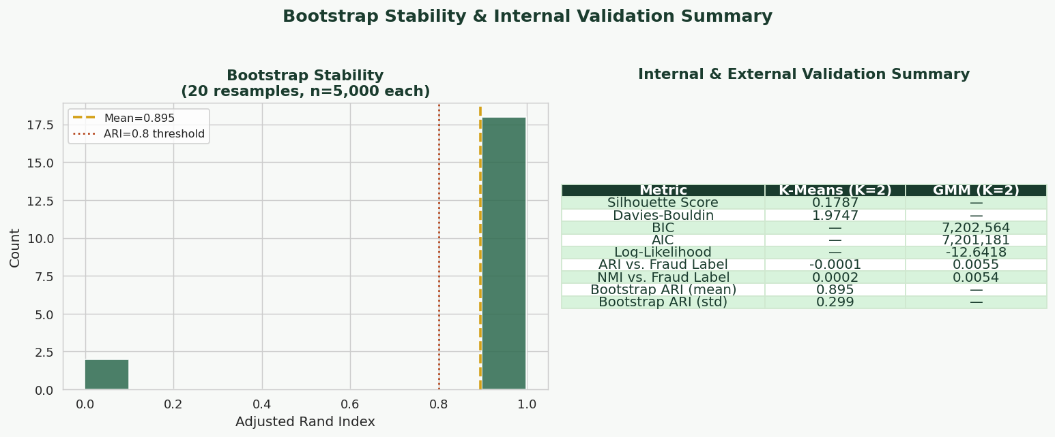

Slide 25
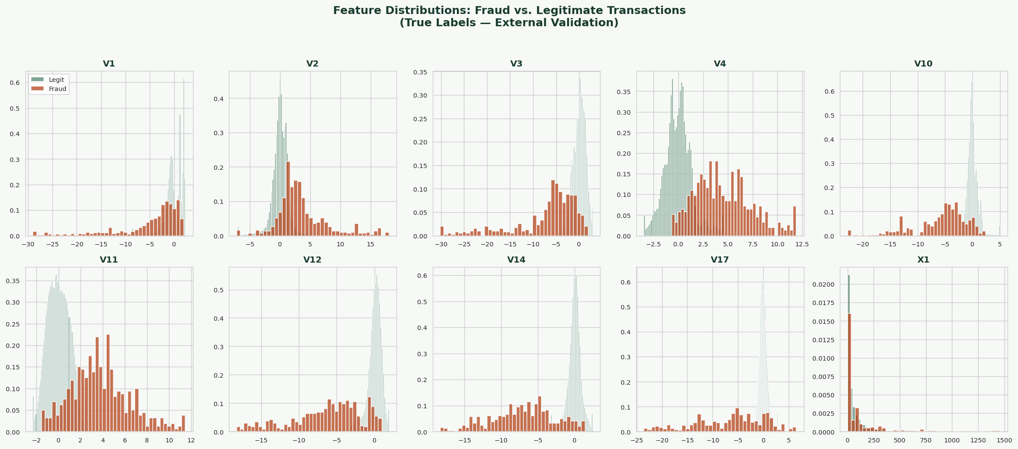

Slide 26
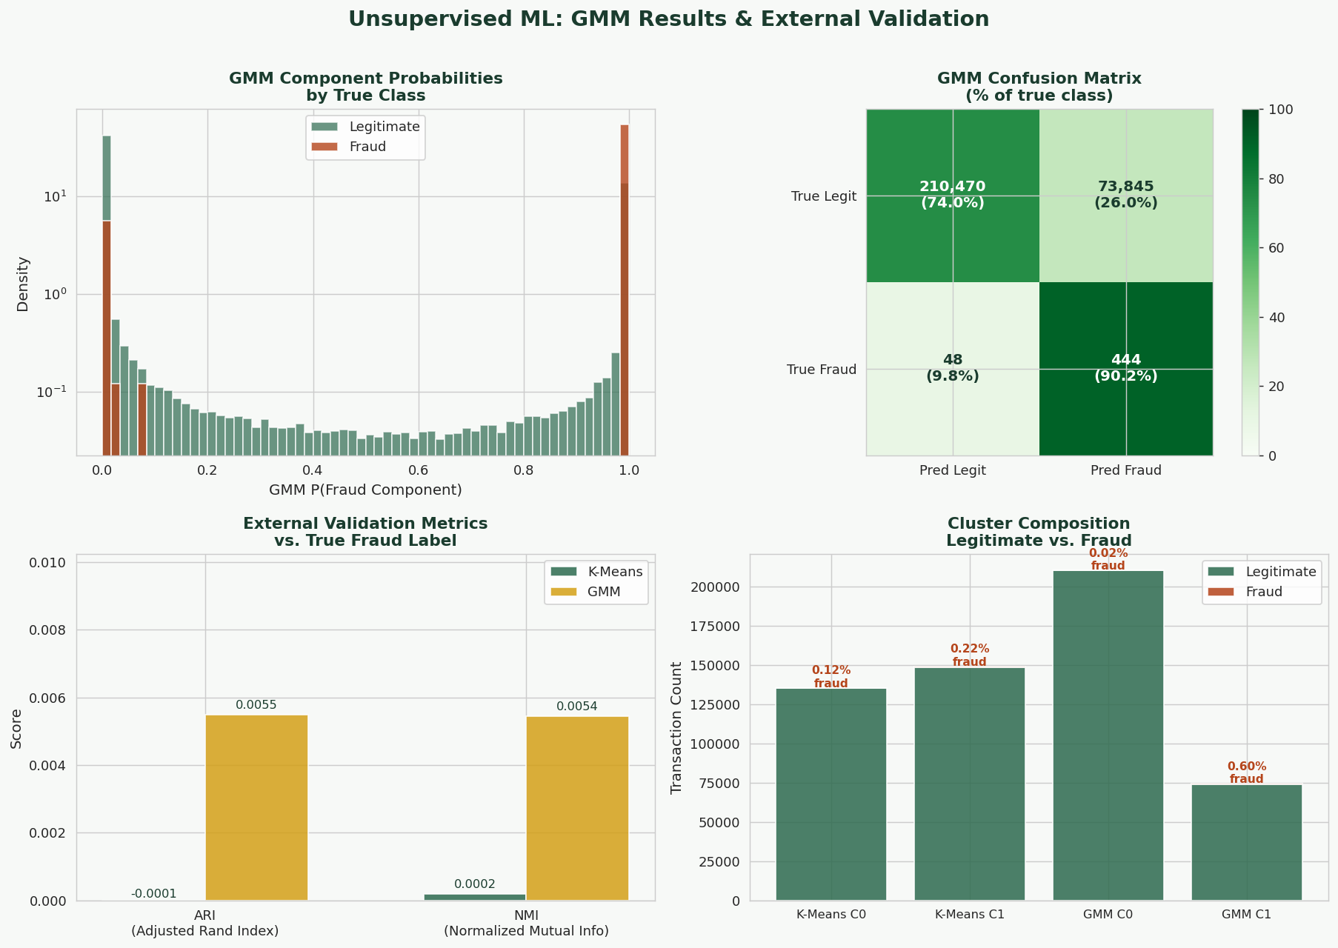

Slide 27
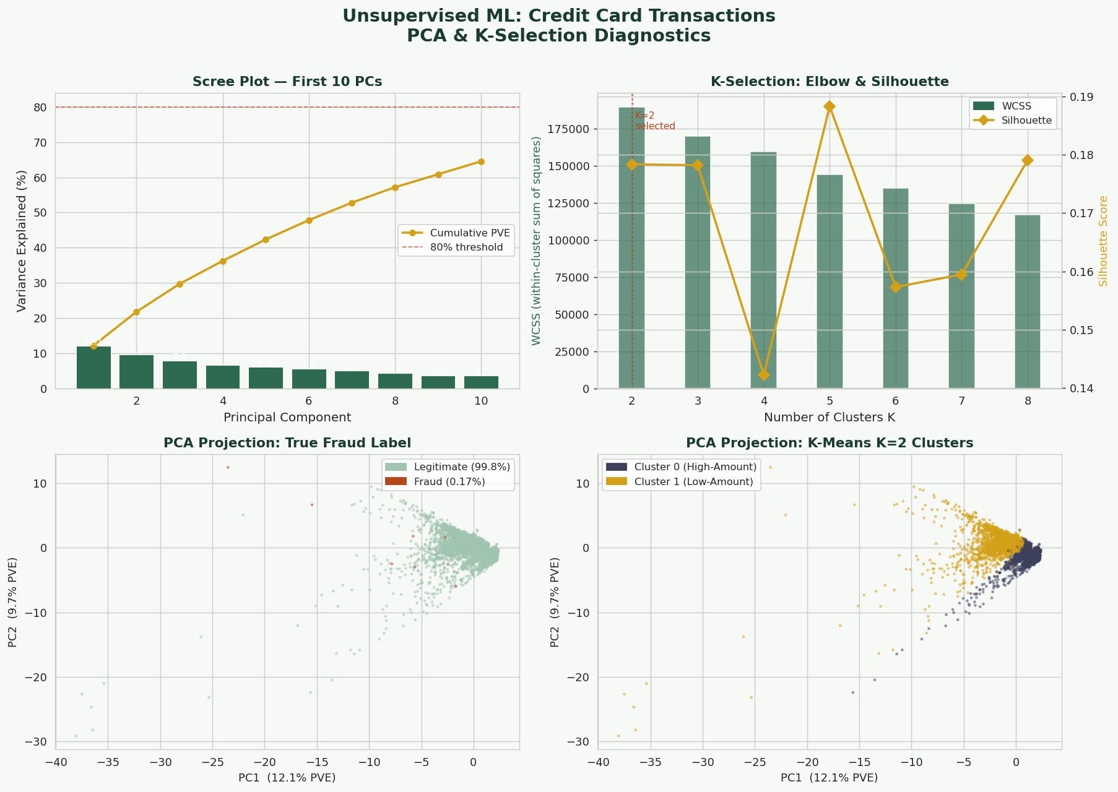

Slide 28
Evaluating Unsupervised Models: Internal & External Criteria
The fundamental challenge: no y means no held-out prediction error. Evaluation requires different strategies.
Internal Criteria (No Labels Needed)
External Criteria (Requires Ground-Truth Labels)
WCSS / Inertia
K-Means objective; lower = tighter clusters. Decreases with K — not useful alone.
Adjusted Rand Index (ARI)
Measures agreement between cluster labels and true labels, corrected for chance. Range: [−1,1], 1=perfect.
Silhouette Score
s(i) = (b−a)/max(a,b) ∈ [−1,1]. Mean over all points; higher = better-separated clusters.
Normalized Mutual Information
MI(C,K)/[H(C)+H(K)]/2. Measures shared information; normalized to [0,1].
Davies-Bouldin Index
Ratio of within-cluster scatter to between-cluster separation. Lower = better.
Fowlkes-Mallows Index
Geometric mean of pairwise precision and recall of cluster assignments.
Calinski-Harabasz
Ratio of between- to within-cluster variance. Higher = better. Favors compact, well-separated clusters.
Purity
Fraction of correctly assigned points if each cluster is labeled by its majority class. Simple but ignores recall.
Reconstruction Error (AE/PCA)
‖X − X̂‖² on held-out data. Analogous to test MSE for supervised models.
V-Measure
Harmonic mean of homogeneity and completeness. Homogeneity: each cluster = one class. Completeness: each class = one cluster.
Log-Likelihood (GMM/KDE)
Held-out log P(x|θ̂). Direct model evaluation in generative frameworks.

Slide 29
Method Comparison: Choosing the Right Unsupervised Tool
Method
Type
Key Assumption
Scalability
Output
K-Means
Clustering
Convex, isotropic clusters; K known
✓ Large n,p
Hard cluster labels
GMM + EM
Clustering/Density
Gaussian components; K known
Moderate
Soft probabilities + density
Hierarchical
Clustering
Distance metric appropriate
✗ Small n
Dendrogram (all K)
DBSCAN
Clustering
Uniform density regions; ε, MinPts set
✓ Moderate n
Hard labels + noise
PCA
Dim. Reduction
Linear manifold; high-var = signal
✓ Large n,p
Linear projections z
t-SNE
Visualization
Local structure; perplexity set
✗ Small n
2D/3D embedding only
UMAP
Dim. Reduction
Manifold hypothesis; topology preserved
✓ Large n
Low-dim embedding
KDE
Density Estimation
Smooth P(X); bandwidth h set
✗ Low p only
Density estimate f̂(x)
Autoencoder
Representation
Data lies on a learnable manifold
✓ Very large n
Latent code z; x̂

Slide 30
Key Takeaways
1
Unsupervised learning discovers structure in P(X) with no target variable — the method choice embeds assumptions about what structure looks like.
2
K-Means minimizes WCSS via coordinate descent; it implicitly assumes spherical, equal-size clusters and is a limiting case of GMM.
3
GMMs are a probabilistic generalization: EM alternates between soft cluster assignments (E-step) and weighted MLE updates (M-step), monotonically increasing log-likelihood.
4
PCA finds the linear subspace of maximum variance via eigendecomposition of the covariance matrix — equivalent to MLE under a PPCA generative model.
5
t-SNE and UMAP are nonlinear methods for visualization; inter-cluster distances in their embeddings are not interpretable — they preserve local topology, not global geometry.
6
KDE is a nonparametric density estimator governed by a bias-variance tradeoff in bandwidth h. It breaks down in high dimensions (curse of dimensionality).
7
Autoencoders learn a compressed latent representation z by minimizing reconstruction loss; VAEs impose a probabilistic prior on z, enabling generation.
8
Evaluating unsupervised models is inherently harder than supervised: use internal criteria (silhouette, BIC, reconstruction error) and external criteria (ARI, NMI) when labels are available for validation.

Slide 31
A Practical Workflow for
& Fitting an
Developing & Fitting an Usupervised ML Model
L Model
& Fitting an
Unsupervised ML Model
9 Steps from Problem Definition to Deployment
Define Goal · Audit Data · Preprocess · Select Algorithm · Fit · Tune Hyperparameters · Interpret · Diagnose · Deploy

Slide 32
The Unsupervised Modeling Workflow at a Glance
1
2
3
4
5
Define
Goal
Audit
Data
Preprocess
& Engineer
Select
Algorithm
Fit
Model
9
8
7
6
Deploy
Diagnose
& Iterate
Interpret
& Validate
Select
Hyperparams
⟳ The workflow is iterative, not linear — diagnostics at Step 8 routinely loop back to Steps 3, 4, or 6.

Slide 33
Step 1: Define the Goal & Choose the Right Method Class
The Governing Question
Why This Step Is Non-Trivial
What kind of structure am I
looking for in P(X)?
Every method encodes assumptions about structure — choosing the method is choosing the model of reality
Misaligned goal → wasted computation and uninterpretable results regardless of execution quality
Key questions to answer before writing code:
Do I expect hard-boundary groups or soft, overlapping ones?
Is the structure likely linear or curved/nonlinear?
Will I need to project new data after fitting?
Is interpretability required, or is prediction quality enough?
How large is n? How large is p?
Document the goal in writing before modeling begins — acts as a north star for every subsequent decision
Segment observations into groups?
→ Clustering: K-Means, GMM, DBSCAN, Hierarchical
Compress to a lower-dimensional space?
→ Dim. reduction: PCA, t-SNE, UMAP, Autoencoder
Estimate the data-generating density?
→ Density estimation: KDE, GMM, normalizing flows
Learn compact feature representations?
→ Representation learning: AE, VAE, contrastive

Slide 34
Step 2: Data Audit — Understanding What You Have
With no y to catch errors, data quality is the single biggest threat to valid unsupervised conclusions.
Distributional Checks
Missing Data
Examine histograms and density plots for each feature
Identify multimodality — may signal subpopulations
Flag extreme skewness: consider log/Box-Cox transforms
Check value ranges for impossible values (age = −3)
Quantify missingness per feature and per row
Is missingness MCAR, MAR, or MNAR?
MNAR is the most dangerous: missingness itself encodes structure
Decide: impute, drop, or retain as a feature?
Outliers & Duplicates
Representativeness
Outliers distort centroids (K-Means) and covariances (PCA/GMM)
Use z-scores, IQR, or Mahalanobis distance to flag
Duplicates inflate cluster density artificially — remove
Keep a record: removed points may be scientifically meaningful
Does the sample reflect the target population?
Sampling bias produces spurious clusters in over-represented groups
Check against known population benchmarks where possible
Unsupervised results are only as valid as the data they were fit on

Slide 35
Step 3: Preprocessing — Scaling, Encoding & Feature Engineering
Most unsupervised algorithms are distance- or variance-based. Unscaled features silently dominate the result.
Scaling & Encoding
Feature Selection & Dimensionality
Z-score standardization (μ=0, σ=1)
Standard for K-Means, PCA, GMM — mandatory when features differ in scale
Min-Max scaling to [0,1]
Useful when bounded range matters; sensitive to outliers
Robust scaling (median/IQR)
Preferred when outliers are present but must be retained
Categorical encoding
One-hot: adds dimensionality but is distance-safe
Embedding: learn a continuous representation (for high-cardinality)
Gower distance: handles mixed-type features natively
Verify: after scaling, no single feature should dominate variance
Curse of dimensionality in clustering:
As p grows, pairwise distances become increasingly uniform
Cluster structure erodes; signal-to-noise ratio falls
Remove irrelevant features before clustering:
High-correlation features add redundancy, not signal
Near-zero-variance features contribute noise
Preliminary PCA before clustering:
Common pipeline: standardize → PCA (retain 80–95% PVE) → cluster
Reduces noise and computation; aids visualization
Domain knowledge is the gold standard for feature relevance — always consult subject-matter expertise

Slide 36
Step 4: Algorithm Selection — Matching Method to Problem
Design Question
Algorithm Guidance
Cluster shape expected?
Spherical/convex → K-Means | Elliptical → GMM | Arbitrary → DBSCAN / Hierarchical
Is K known in advance?
Yes → K-Means, GMM | No → DBSCAN, Hierarchical (full dendrogram)
Soft vs. hard assignments?
Hard (one cluster per point) → K-Means, DBSCAN | Soft (probabilities) → GMM
Outliers / noise expected?
Yes → DBSCAN (labels noise), robust K-Medoids | No → K-Means or GMM fine
Dimensionality reduction?
Linear structure → PCA | Nonlinear, visualization → t-SNE / UMAP | General nonlinear → Autoencoder
Need out-of-sample transform?
Yes → PCA, UMAP, Autoencoder | No → t-SNE acceptable
Scale (n, p)?
Very large n → K-Means, UMAP, Autoencoder | Small n → Hierarchical, KDE | High p → PCA first, then cluster
⚑ Algorithm choice embeds assumptions. Document the rationale — it becomes the first paragraph of your methods section.

Slide 37
Step 5: Fitting — Initialization, Convergence & Best Practices
Fitting is not a single button-press. Initialization strategy and convergence monitoring both affect solution quality.
Initialization Strategy
Convergence Monitoring
K-Means: use K-Means++ (not random restart)
K-Means++ selects initial centroids proportional to distance² from existing centroids — reduces bad initializations
GMM / EM: initialize μₖ from K-Means run; helps EM converge to better local maxima
Always run multiple restarts (≥10) for any stochastic algorithm
Report the best solution (lowest WCSS / highest log-likelihood) across restarts
Neural network AEs: standard techniques (Xavier init, batch norm, Adam optimizer)
Track the objective per iteration: WCSS for K-Means, log-likelihood for GMM/EM, reconstruction loss for AE
Plot the learning curve — a flat plateau signals convergence; non-monotonic behavior signals a bug
K-Means: declare convergence when no point changes cluster assignment between iterations
EM: convergence when |ℓ(θᵗ) − ℓ(θᵗ⁻¹)| < ε (e.g., 10⁻⁶)
PCA: deterministic — no iteration needed; verify eigenvalues are non-negative
Slow convergence often signals: wrong K, unscaled features, or poorly separated clusters

Slide 38
Step 6: Hyperparameter Selection — The Hardest Step
Without a target variable, there is no single held-out loss to minimize. Multiple criteria must be examined together.
Hyperparameter
Methods
Selection Criteria
Key Caveat
K (number of clusters)
K-Means, GMM, Hierarchical
Elbow plot (WCSS), silhouette score, gap statistic, BIC/AIC (GMM). Dendrogram cut height for hierarchical.
No single criterion is definitive. Use ≥2 criteria and domain knowledge.
k (number of components)
PCA, Factor Analysis
Cumulative PVE ≥ 80–95%, scree plot elbow, Kaiser criterion (λ > 1), parallel analysis, CV on reconstruction error.
Retain the fewest components that preserve interpretable structure.
ε, MinPts
DBSCAN
k-distance plot: plot sorted distance to k-th nearest neighbor; ε at the 'elbow'. MinPts ≥ ln(n) as a starting rule.
Very sensitive; different settings produce radically different cluster counts.
Bandwidth h
KDE
Silverman's rule of thumb: h* = 1.06σn^{−1/5}. Or cross-validate held-out log-likelihood.
Optimal h depends on true density shape; Silverman assumes Gaussian.
n_neighbors, min_dist
UMAP
No formal criterion — explore visually. n_neighbors controls local vs. global structure balance.
Results are stochastic and layout depends strongly on these parameters.
Latent dim k, architecture
Autoencoder
Reconstruction error on held-out data vs. k. Elbow in reconstruction loss curve.
Over-parameterized AE memorizes rather than compresses — use held-out set.

Slide 39
Step 7: Interpretation & Validation — Making Sense of Structure
A fitted model produces labels, projections, or embeddings — but meaning must be constructed through interpretation.
Cluster Profiling
Dimensionality Reduction Interpretation
Compute mean, SD, and distribution of each feature within each cluster
Use ANOVA / Kruskal-Wallis to test which features differ significantly across clusters
Visualize: heatmap of cluster centroids; box plots by cluster
Ask: does each cluster have a coherent, interpretable identity?
Name the clusters based on their profiles — not their index numbers
PCA: examine loadings — which features load heavily on PC1, PC2?
Biplot: overlay feature vectors on score plot to see structure simultaneously
t-SNE / UMAP: visual inspection only — cluster separation is informative; distances between clusters are NOT
Confirm that embedding structure aligns with domain expectations
Stability Analysis
External Validation
Refit on bootstrap resamples or random subsets of the data
Stable solutions reproduce themselves under perturbation
Compute ARI between pairs of bootstrap solutions — median ARI > 0.8 suggests robust structure
Unstable solutions indicate noise-driven clusters, not genuine population subgroups
If known labels exist (even unused in fitting), compare with ARI or NMI
Check if clusters align with theoretical groupings from domain literature
Run a supervised model predicting cluster membership from features — high accuracy confirms cluster separability
Partial labels: use labeled subset as a sanity check only, not for tuning

Slide 40
Step 8: Diagnosis & Iteration — The Most Common Failure Modes
Symptom
Likely Cause
Corrective Action
One cluster is a 'catch-all' with very high n
K is too small; genuine sub-groups are lumped together
Increase K; re-examine elbow / silhouette; split and re-cluster the large group
WCSS / log-likelihood varies widely across restarts
Multiple local optima; poorly separated clusters; bad initialization
Use K-Means++ initialization; increase n_init; reconsider K
t-SNE / UMAP produces a single blob
n_neighbors or perplexity too large; no real cluster structure
Reduce n_neighbors; try PCA first to remove noise dimensions
PCA PC1 explains >90% of variance
One feature dominates (scaling omitted, or single noisy feature)
Verify all features are standardized; check for near-constant features or outlier-driven variance
EM does not converge / degenerates
A Gaussian component collapses onto a single point (Σₖ → 0)
Add regularization to Σₖ; use diagonal covariance; reduce K; try better initialization
Clusters change dramatically across bootstrap resamples
Structure is noise-driven, not genuine; n is too small
Increase n; reduce K; switch to a more regularized method (GMM with BIC); report instability honestly
Reconstruction error high (Autoencoder)
Latent dim k too small; network underpowered; insufficient training
Increase k or network depth; train longer; check for data preprocessing errors

Slide 41
Step 9: Communication & Deployment
The audience for results is the domain — not the algorithm. Cluster 1 must become a name, not a number.
Communicating Unsupervised Results
Deploying Unsupervised Models
Name and describe clusters in domain terms
'High-engagement, low-tenure users' not 'Cluster 3'
Lead with the structure, not the method
Report the evidence for stability — bootstrap ARI, sensitivity to K, silhouette distributions
For PCA: explain each retained PC in terms of the original features, not just variance explained
Be explicit about what the model cannot tell you:
t-SNE distances are not metric
Cluster membership is not a causal category
Visualizations of high-dimensional structure are always partial
Acknowledge the assumptions embedded in the chosen method
Save the fitted model artifacts:
K-Means: cluster centroids + scaler parameters
PCA: projection matrix V, mean vector, scaler
GMM: {πₖ, μₖ, Σₖ}
Autoencoder: trained encoder weights
Out-of-sample projection support:
✓ PCA, UMAP, K-Means (nearest centroid), AE: all support it
✗ t-SNE (basic form): does not generalize to new points
Monitor distribution shift: if the incoming data distribution P(X) changes, cluster assignments will degrade silently
Periodic retraining cadence should be defined upfront — unsupervised models have no performance metric that triggers automatic retraining

Slide 42
The Overarching Principle: Assumptions All the Way Down
"Every algorithmic choice encodes assumptions about structure — the workflow is not merely computational but fundamentally conceptual."
Method
Embedded Assumption
K-Means
Clusters are convex and similarly sized; Euclidean metric is appropriate
GMM
Observations arise from a mixture of Gaussians; EM finds ML parameters
DBSCAN
Clusters are density-connected regions; noise points are identifiable
PCA
Signal lives in a linear subspace; large variance = important structure
t-SNE
Local neighborhood structure (perplexity-defined) captures true proximity
UMAP
Data lies on a manifold; topological structure can be preserved in low-dim
KDE
P(X) is smooth; bandwidth h controls the bias-variance tradeoff
Autoencoder
Data lies near a lower-dimensional manifold learnable by a neural network

Slide 43
Key Takeaways
1
Define the goal before choosing a method — the method choice encodes assumptions about what structure looks like.
2
Data quality is paramount with no y to catch errors. Audit distributions, missingness, outliers, and representativeness.
3
Scaling is mandatory for distance- and variance-based methods. Feature selection reduces noise before fitting.
4
Run multiple restarts for stochastic algorithms (K-Means, EM). Monitor the objective curve — non-convergence signals a problem.
5
Hyperparameter selection (K, k, ε, h) is the hardest step. Use multiple internal criteria together, not any single one.
6
Interpret output in domain terms: profile clusters, examine PCA loadings, test stability with bootstrap resampling.
7
Diagnose failure modes systematically — catch-all clusters, degenerate EM, and unstable solutions each point to specific fixes.
8
Document assumptions at every step. The methods section of a paper is a record of every assumption made in this workflow.

